Slide 1
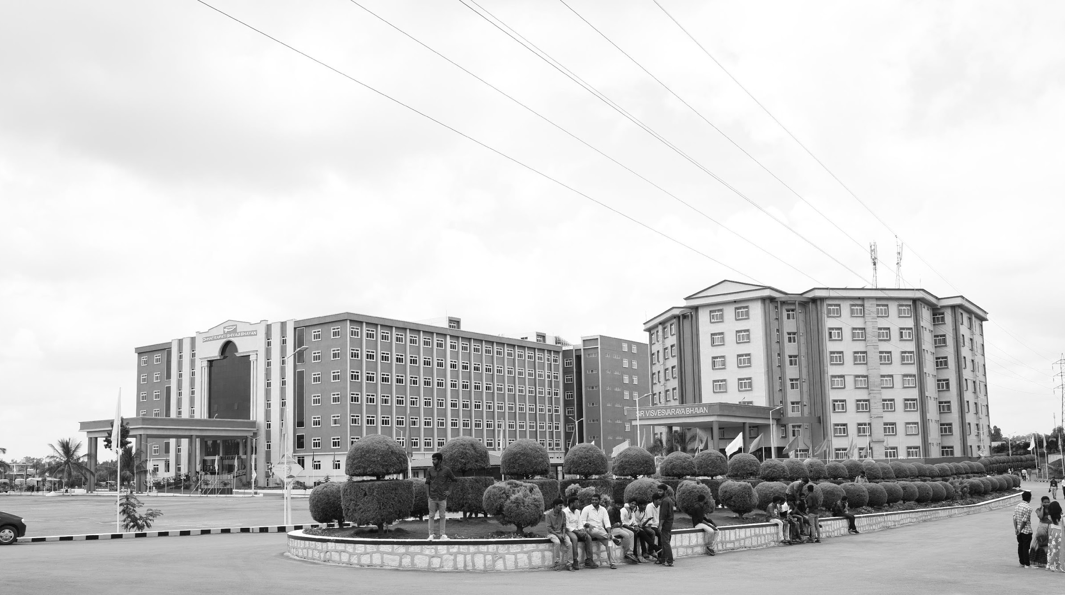

Modular Solar Power Based Harvest Drying Machine
Mid-Review 1
Major Project
Project ID: XX
AY 2021-25
GITAM (Deemed-to-be) University
Department of Electrical Electronics and Communication Engineering
Project Team:
CHALLA SANTHOSH
Project Mentor:
Prof. Prithvi Sekhar Pagala
Project In-charge:
Dr.Rohan Prasad
www.gitam.edu

Slide 2
Objective and Goals
Objective
The objective of this project is to design and develop a Modular Solar Power-Based Harvest Drying Machine that delivers better performance, higher efficiency, and lower cost compared to existing drying solutions. By using solar energy and innovative design, the machine aims to help farmers with a sustainable, affordable, and user-friendly drying system that reduces post-harvest losses, preserves crop quality, and increases profitability,To reduce the wastage of the food and making profitable for both farmer and invester.
Goals
Main Goals
To reduce the time period of drying the product
Innovattive Design
To reduce cost of the drying machine
Sustainable
Additional Goals
Adding IOT solutions to machine
Smart and Digital Operating

Slide 3
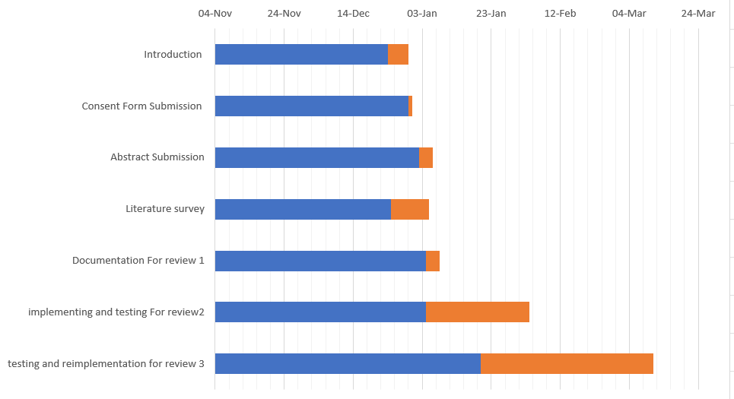
Project Plan (Clearly mention milestone for objectives under each reviews)

Slide 4
Literature Survey (Improved post minor project)
Key Publications
Review of solar-energy drying systems II: an overview of solar drying technology
Performance study of different solar dryers: A review
A Review of Solar Dryer Technologies
Key Resources – Whitepaper| Application Notes | Datasheet| Others
https://github.com/Gillou38/Drying-open-source-solution
https://github.com/franzdrs/Solar_drying_with_latent_heat_storage
https://www.ijtrd.com/papers/IJTRD21889.pdf
Existing Implementations – Products| Opensource| GitHub etc
currently existing model and technology
https://www.youtube.com/watch?v=NLsRdKYU2l4

Slide 5
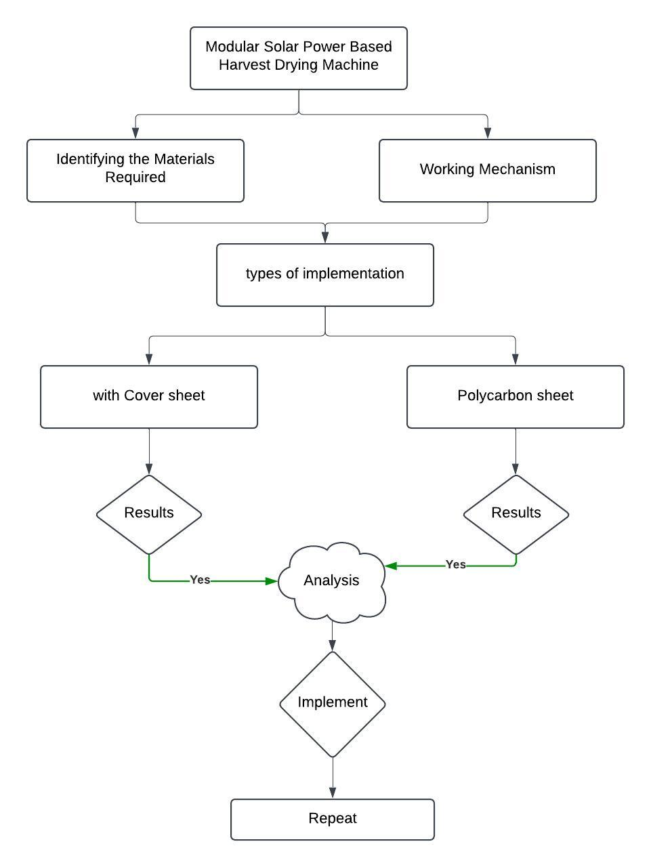
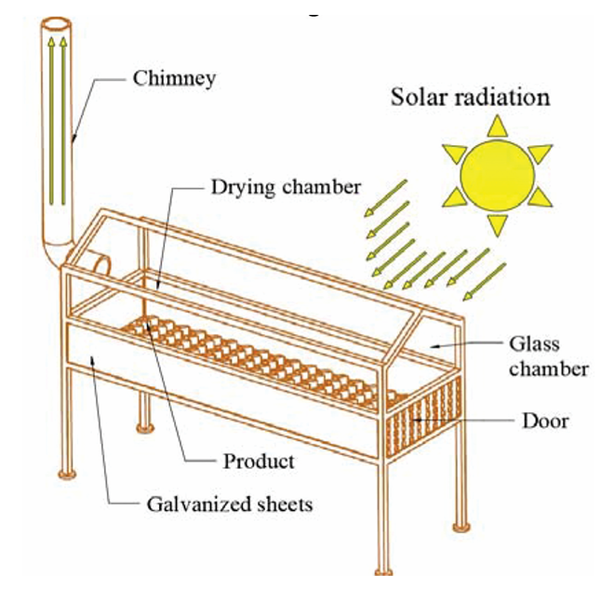
Architecture
Structural Diagram

Slide 6
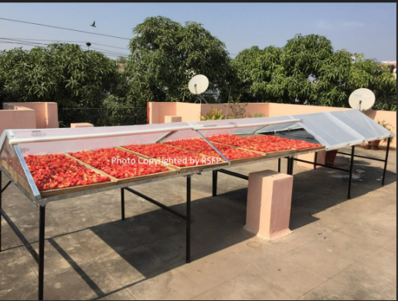
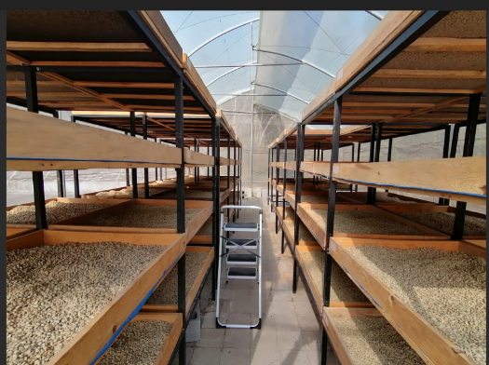
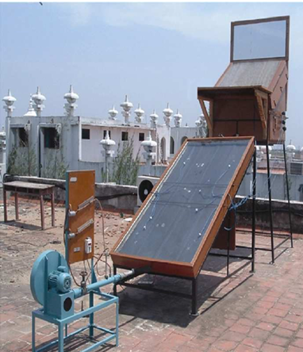
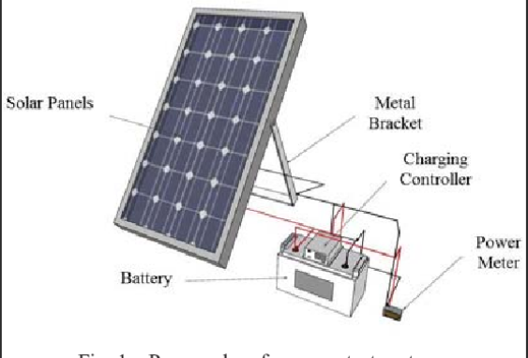
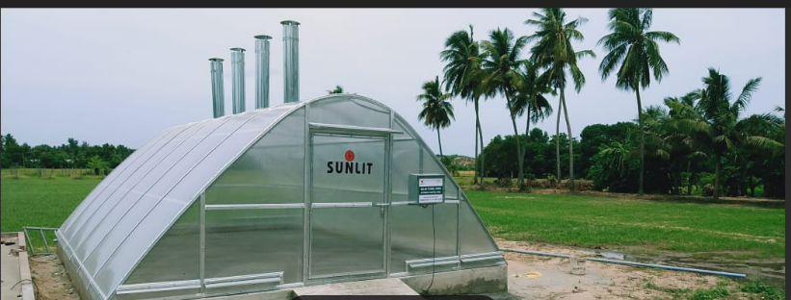
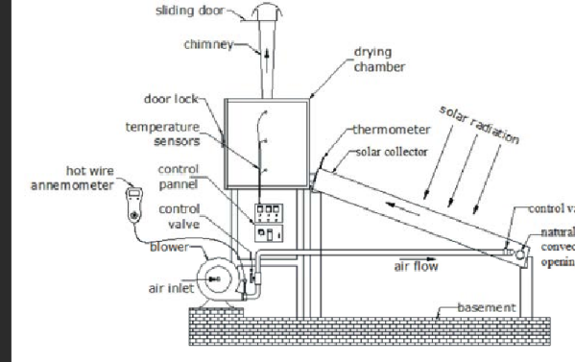
Use Cases & Testing
Use Cases
Those who are using solar pwoer in the home
Farmers can use
new bussiness (anyone with the investment )
Test Cases
Working in all weather conditions
Hybrid operation
Temperature control

Slide 7
Implementation and Results – Iteration 1
Iteration 1 :
Primary Material: Polycarbonate sheets for solar collector and drying chamber covers—high transparency, excellent insulation, and durability ensure efficient heat trapping and long-term use.
Secondary Material: Polyethylene film for temporary testing or insulation layers—low cost and easy installation make it ideal for prototyping.
Material type | Transparency | Durability | Cost
Polycarbonate Sheets | High (up to 90% light transmission) | High (impact-resistant, long-lasting) | ₹830–₹1,660 per m²
Acrylic Sheets | High (up to 92% light transmission) | Moderate (less impact-resistant than polycarbonate) | ₹1,037–₹2,075 per m²
Glass Sheets | High (up to 90% light transmission) | High (but fragile and prone to breaking) | ₹1,153–₹2,306 per m²
Fiberglass Panels (FRP) | Moderate (translucent, diffuses light) | High (resistant to weathering and corrosion) | ₹432–₹865 per m²
Polyethylene Film | Moderate (varies based on thickness) | Low to Moderate (prone to tearing and UV degradation) | ₹166–₹415 per m²

Slide 8
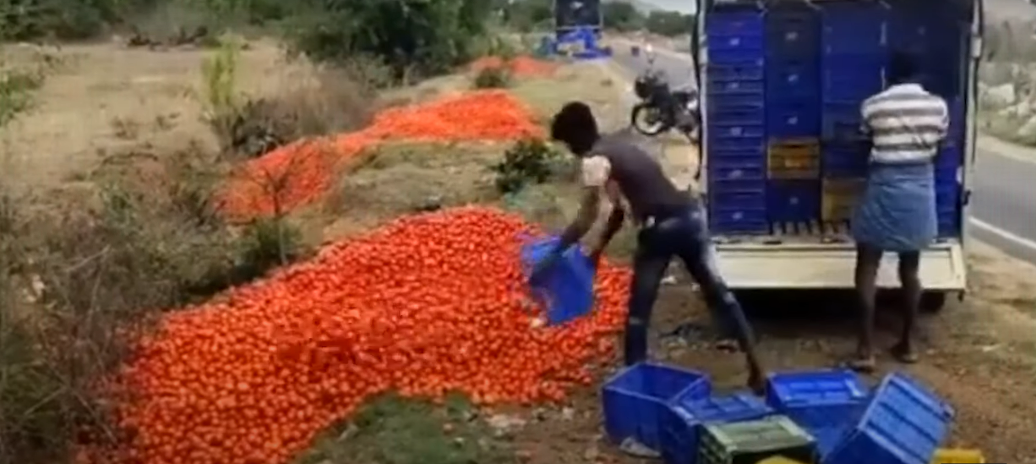
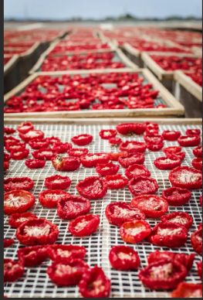
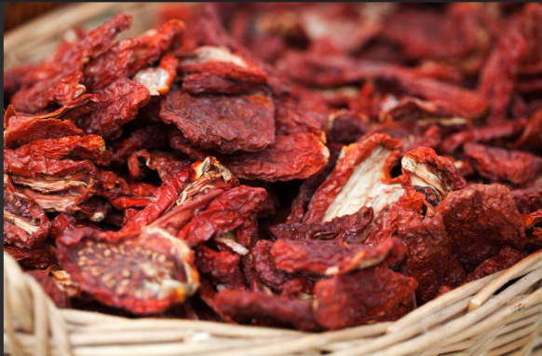
Implementation and Results – Iteration 2
Iteration : Results + Validation against the use cases and test cases
Farmers often face losses when there’s no market demand for fresh produce like tomatoes, forcing them to discard their crops. By using the solar dryer, we can add value to their produce by drying it, ensuring no waste. For example, if fresh tomatoes cost ₹10–₹20 per kg and can only be stored for 7–10 days, dried tomatoes can fetch ₹100–₹200 per kg and be stored for 6–12 months, providing farmers with a profitable alternative and reducing post-harvest losses. Additionally, dried tomatoes are lightweight, easier to transport, and have a higher demand in markets for processed foods, snacks, and exports. This value addition transforms surplus produce into a sustainable income source while minimizing storage and transportation challenges.

Slide 9
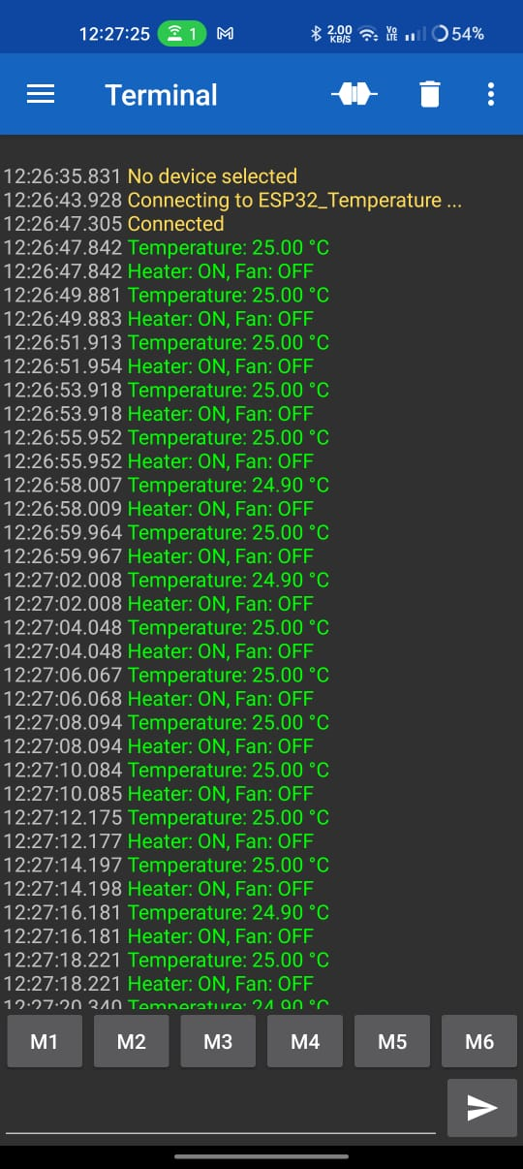
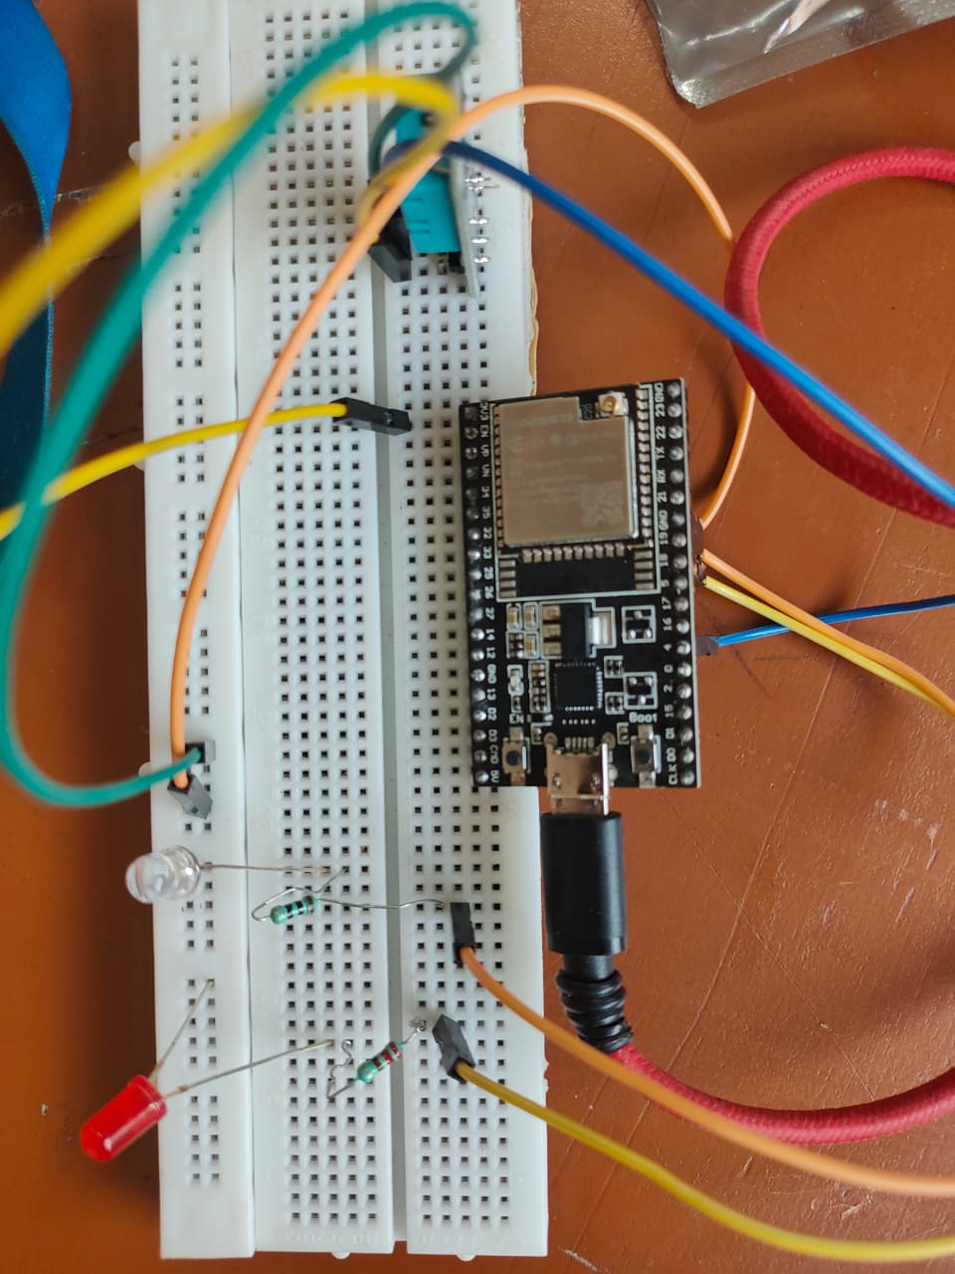
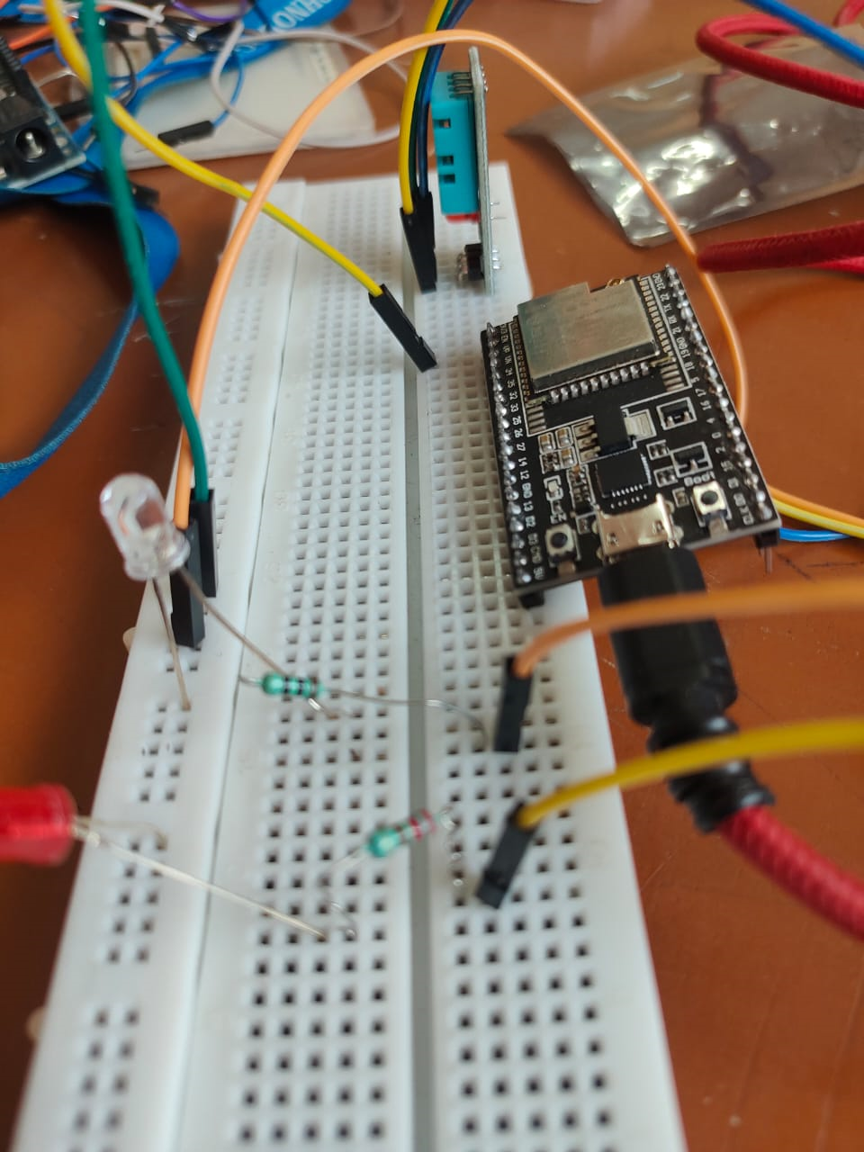
Implementation and Results – Iteration 3
Iteration : Results Hardware Implementation , Physical Prototype , Caluclations

Slide 10
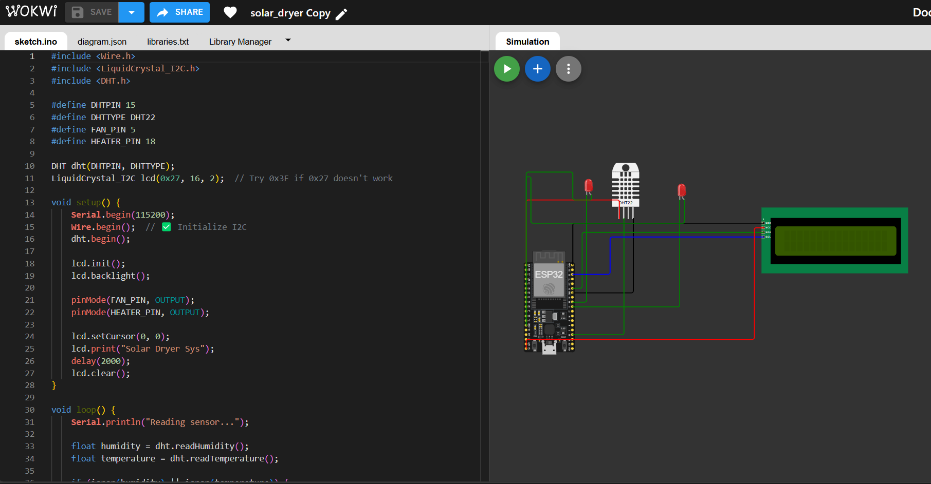

Slide 11
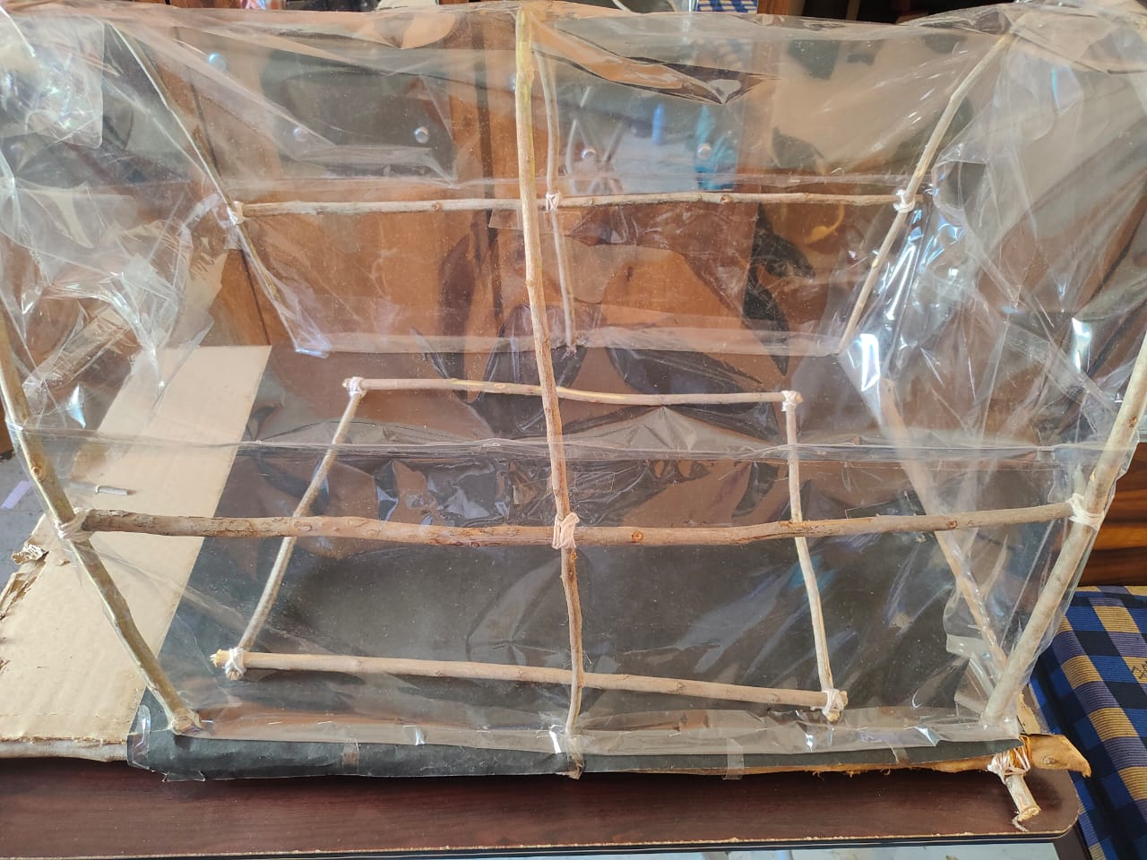
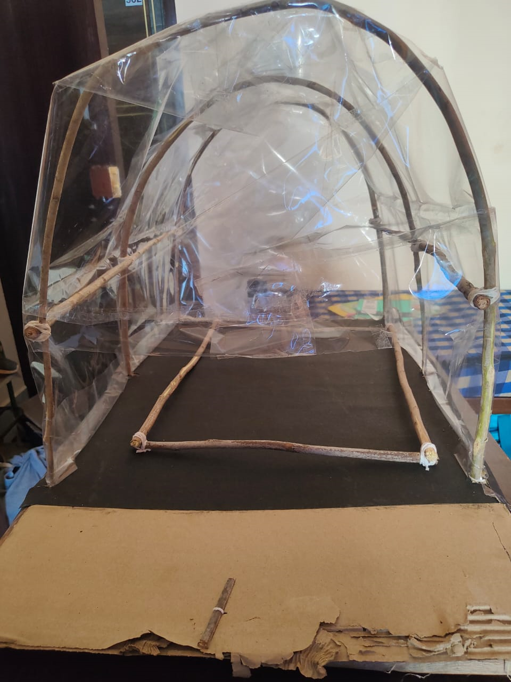
Physical Prototype

Slide 12
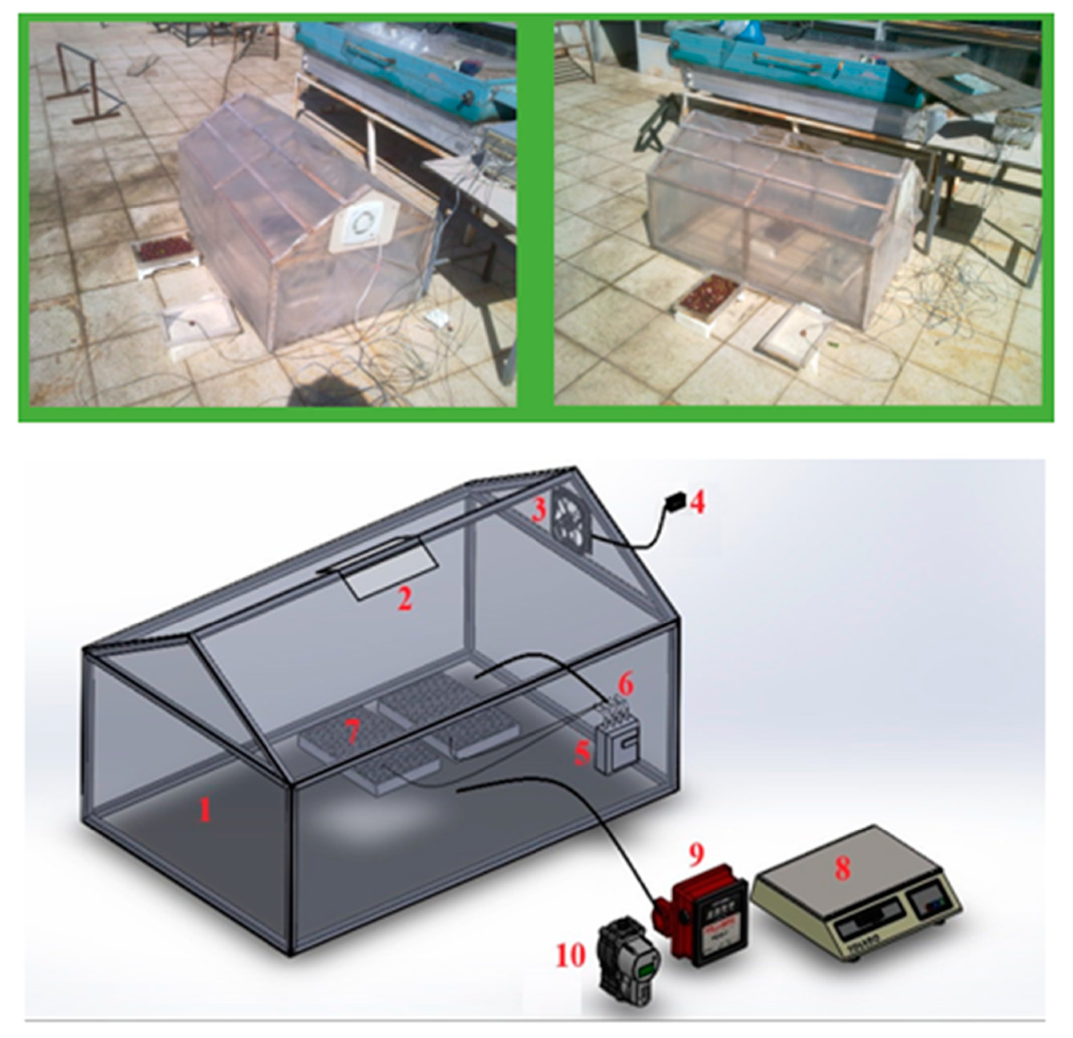
Sample Model
The experimental setup: (1—Drying Room, 2—Chimney, 3—Fan, 4—Reosta, 5—Digital Thermometer and Channel Selector, 6—Thermocouples, 7—Trays, 8—Scales, 9—Moisture Meter, 10—Solar Radiation Meter).

Slide 13
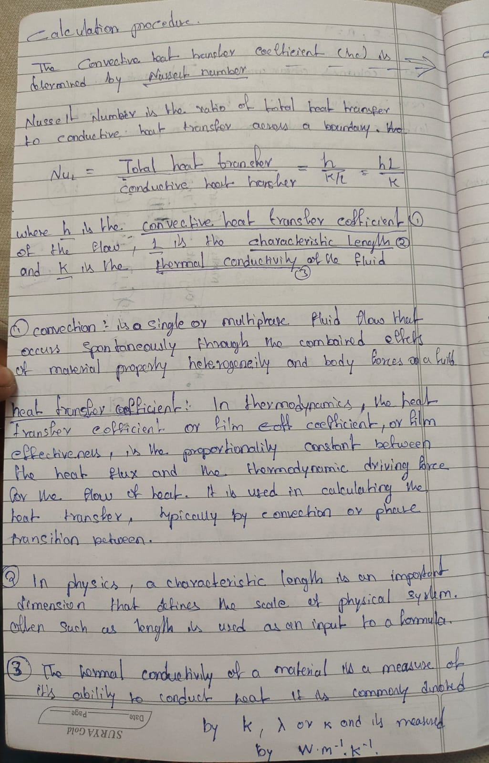
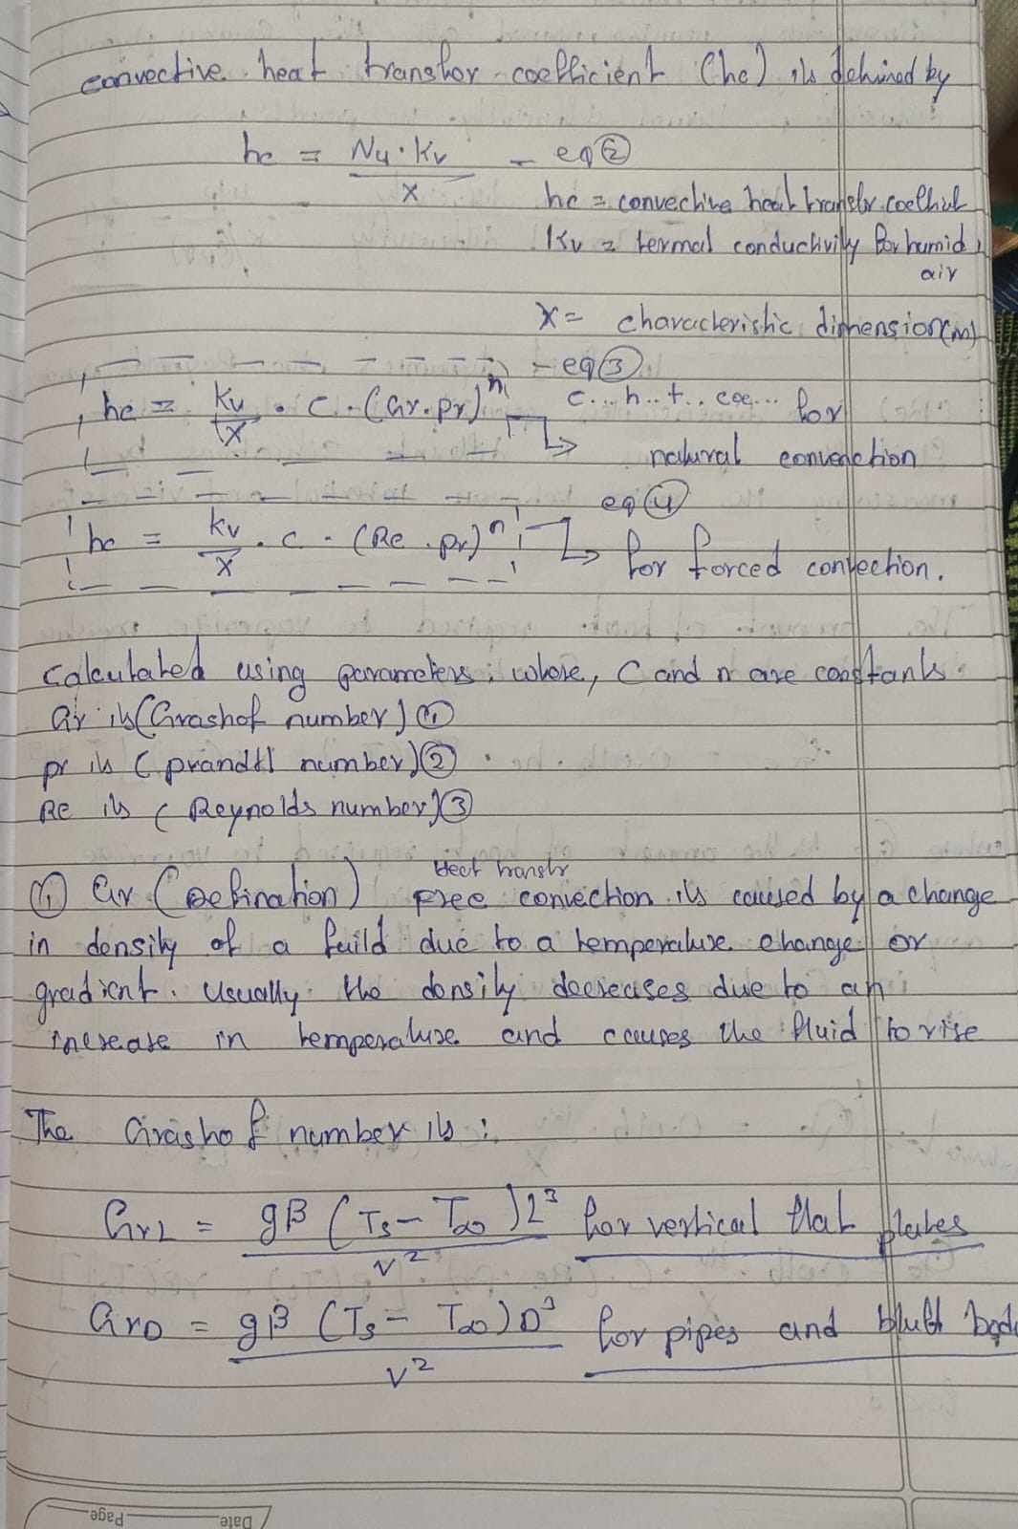
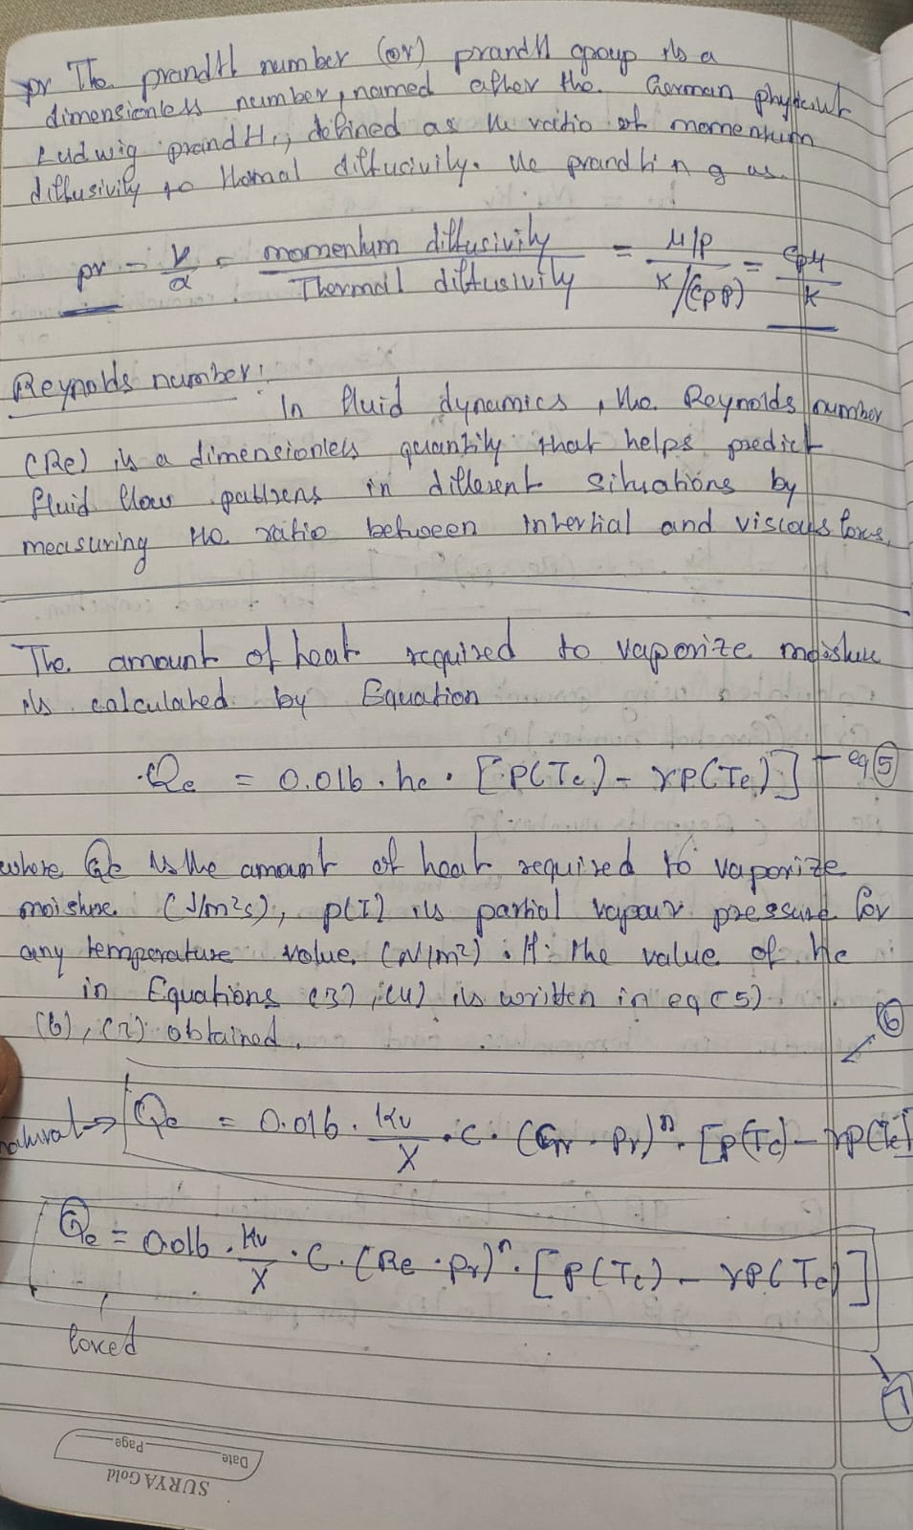
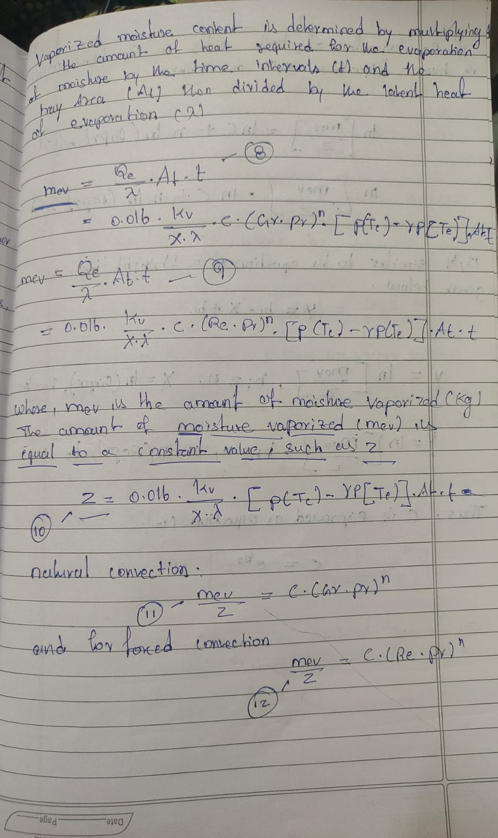
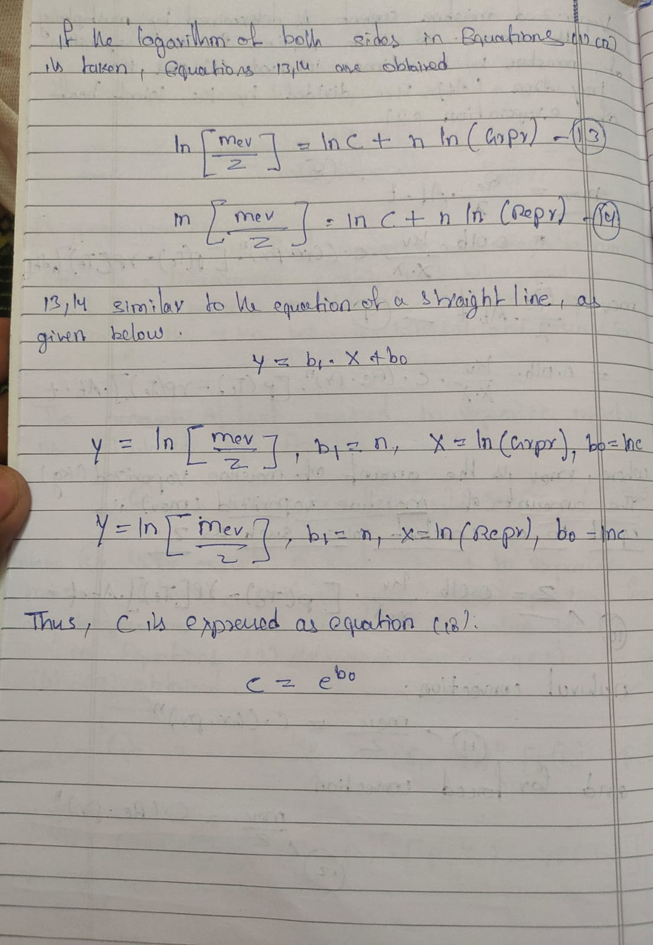
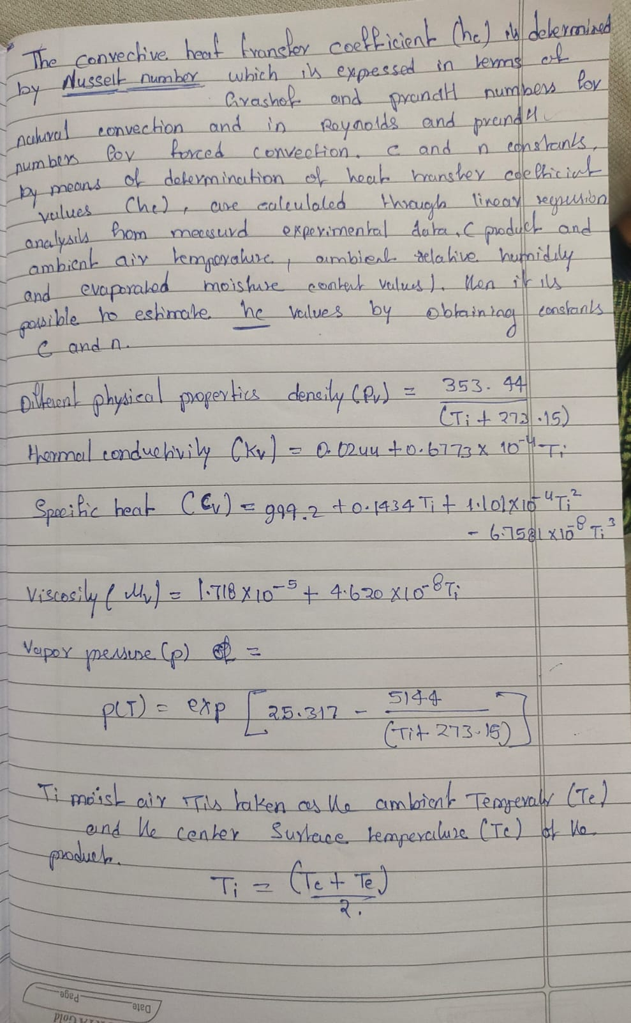
Caluclations

Slide 14
Contribution
Individual Contribution
Key contributions: Challa Santhosh
Idea
Design
Haedware Implementation
Physical prototype
Caluclations

Slide 15
Conclusion & Future Work
Summary and Conclusion
Farmers frequently suffer losses due to low market demand for fresh produce, resulting in significant waste and financial challenges. Annually, 18% of post-harvest produce is wasted, costing ₹13,330 crore. The Modular Solar Power-Based Harvest Drying Machine addresses this by converting fresh produce (7–10 days storage) into dried goods (6–12 months storage), preventing waste and generating profit. Dried produce is lightweight, easy to transport, and highly sought after for processed foods and exports. This solution reduces post-harvest losses, provides farmers with a sustainable income, and enhances food security. By transforming surplus produce into valuable dried goods, it supports farmers financially and promotes a sustainable future for agriculture.
Future Work
Modular Solar Power Based Harvest Drying Machine for this project future work is to collect all the materials required and implementing prototype , testing and based on the results reimplementing until reaching our requirements.
Integration of matlab script to model to predict the efficiency of the crop and profit losses and analysis of it like mainting the temperature up to required conditions.

Slide 16
THANK YOU
Have a Great Day !

